Slide 1


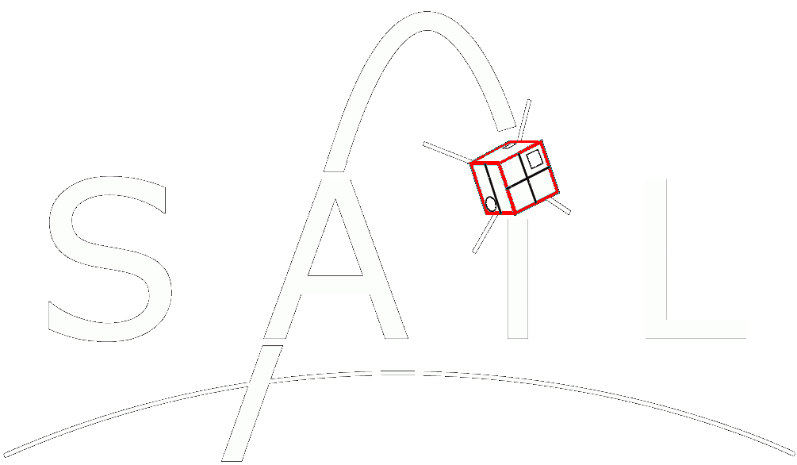
SPICE modeling for Langmuir probe simulation and estimating spacecraft charging
Aroh Barjatya
Space and Atmospheric Instrumentation Laboratory
Embry-Riddle Aeronautical University
sail.erau.edu

Slide 2
Langmuir Probe Basic Theory
Typical Op-Amp based Langmuir probe circuit and an I-V curve

Slide 3
Langmuir Probe Basic Theory …Contd.
Notes:
Plasma...Energy equivalent==>Electrons fast... thus if only ion and electron currents then the spacecraft charges negative.
PE important at GS high altitudes...
Also talk about sheath at this point… how sheath shield the plasma from any fields…

Slide 4
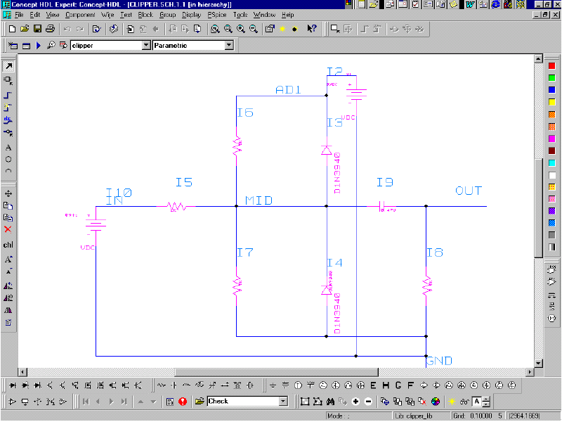
SPICE
SPICE - Simulation Program with Integrated Circuit Emphasis
An industry standard simulation program used by electrical engineers for simulating networks of linear and non-linear circuit elements. [Keown, 2001]
Uses numerical methods to solve non-linear equations
70+ years of heritage
Multiple commercial options: Cadence PSPICE, Analog Device’s LT Spice, ngSpice, gnuCAP, and many more. All use similar programming syntax.

Slide 5
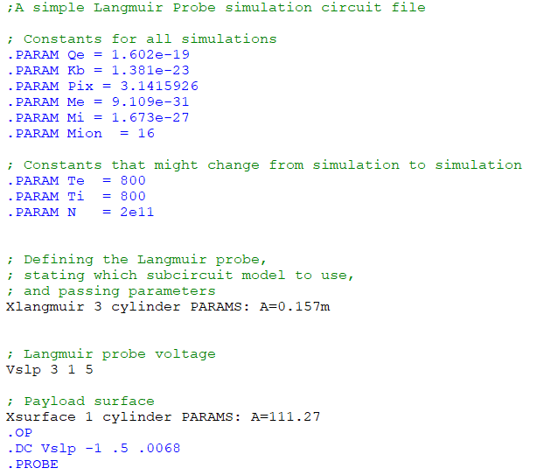

Sample SPICE Program
The SPICE programming file extension is *.cir
All comments begin with a semicolon ( ; )
“.PARAM” sets global variables/constants
R, C, L, V, etc have their regular meaning
You specify Rxx, Cxx, Lxx, Vxx for specific devices
The .cir file should always end with “.END”
Node 0 is always the circuit Ground and each device needs to be connected between two nodes… just like on a breadboard. If not specified its assumed to be node 0, i.e. GND. You cannot have floating nodes.
Typically nodes are numbered and specified immediately after the device type and the third number is the value assigned to the device
R 3 2 100 or R 3 2 1meg or C 3 2 5u or L 3 2 1m
X is a special device used for “.subckt” i.e. a function

Slide 6
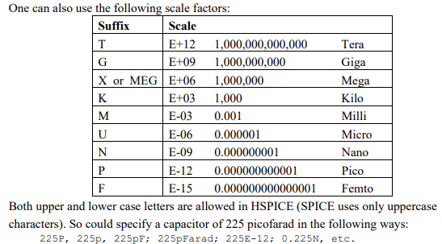
SPICE scaling factors
You can specify the same value in many different ways although be careful with CASE as different spice compilers handle them differently.

Slide 7


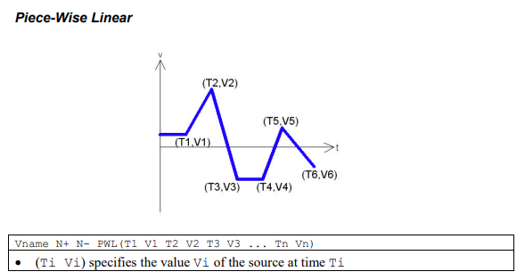
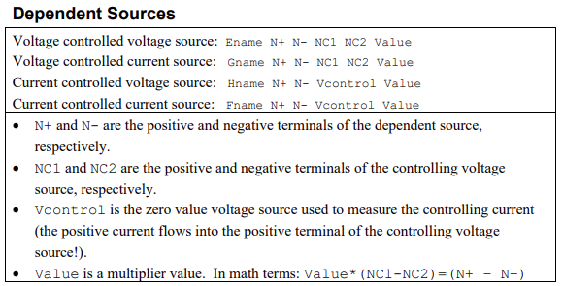
Types of sources

Slide 8
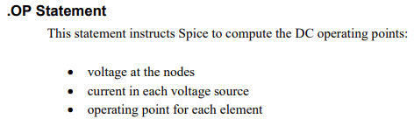
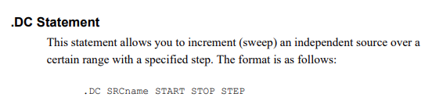
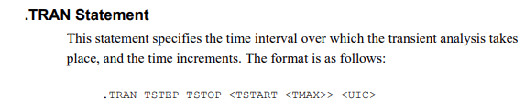
Types of Control Statements

Slide 9
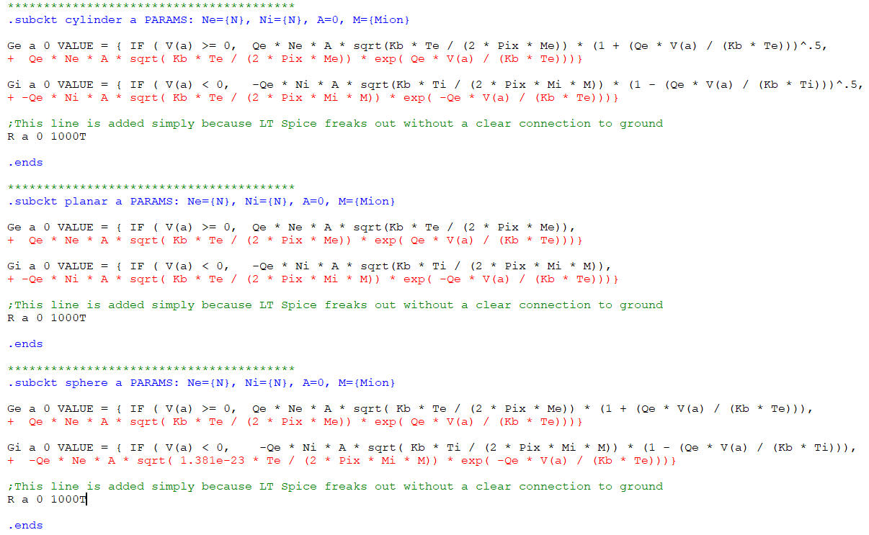
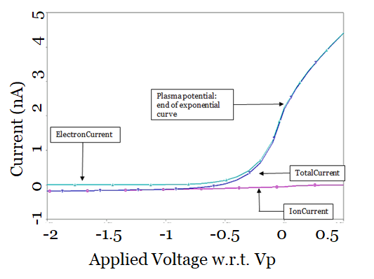


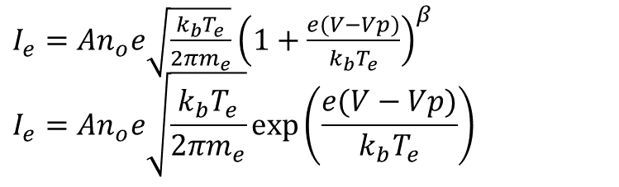
Introducing Sub-Circuits in SPICE
Create a Voltage-Dependent-Current-Source, specified with element “G”
Use Langmuir Probe Current Collection Equations
$$β=0.5=cylinder$$
$I_{e}=An_{o}e\sqrt{\frac{k_{b}T_{e}}{2πm_{e}}}$ ${\left(1+\frac{e(V−Vp)}{k_{b}T_{e}}\right)}^{β}$ $$I_{e}=An_{o}e\sqrt{\frac{k_{b}T_{e}}{2πm_{e}}}\exp\left(\frac{e(V−Vp)}{k_{b}T_{e}}\right)$$
$$V≥Vp$$ $$V<Vp$$
Spacecraft Conducting Surface
V_{f}
subckt
G_{i}
G_{e}
=
V_{p}
Plasma

Slide 10
Variation of plasma parameters

Slide 11
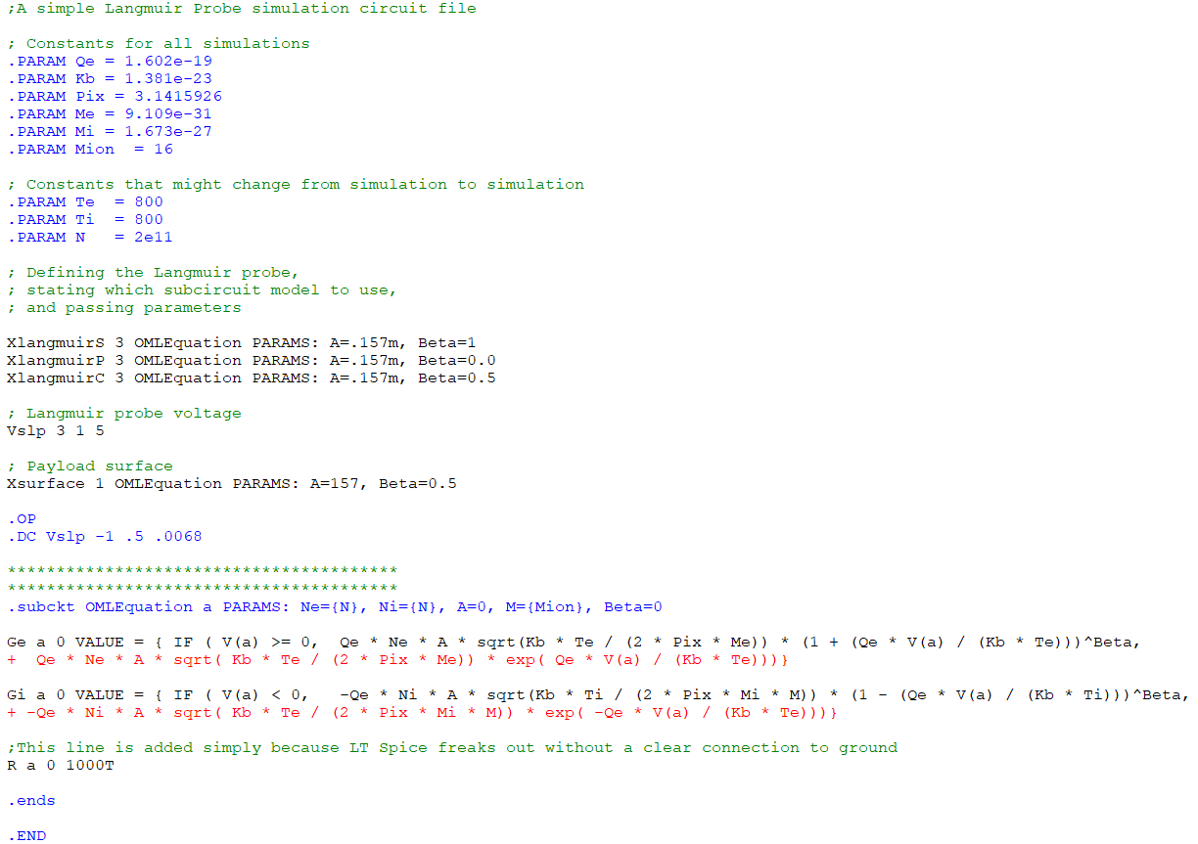
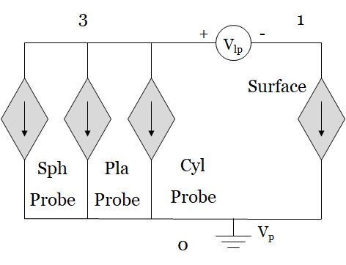
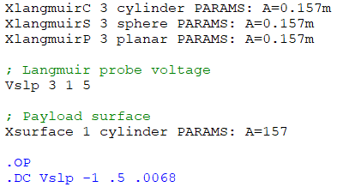
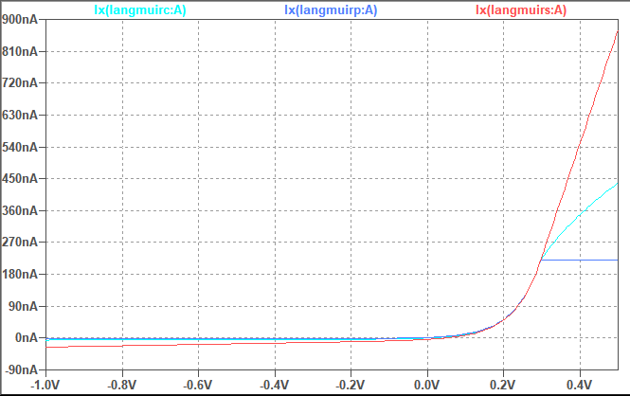
Doing multiple subcircuits with different geometries

Slide 12
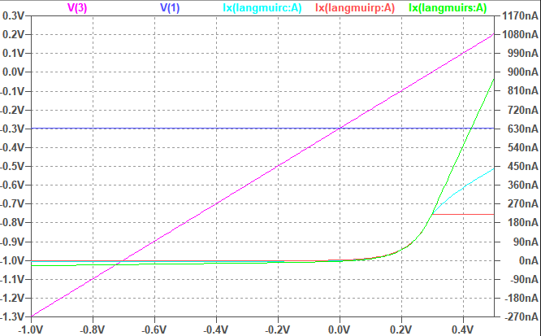
Simulating Various Geometries of Langmuir Probes
3
1
+
-
V_{lp}
Surface
Sph
Probe
Pla
Probe
Cyl
Probe
V_{p}
0

Slide 13
Understanding Floating Potential

Slide 14
Simulating Area Ratio Effects
Probe
E+
E+
e-
e-
E+
Ip
e-
E+
E+
e-
+
e-
e-
E+
V_{lp}
E+
e-
e-
e-
E+
-
E+
e-
e-
E+
Ir
E+
e-
e+
Surface

Slide 15
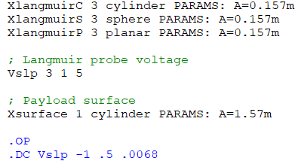
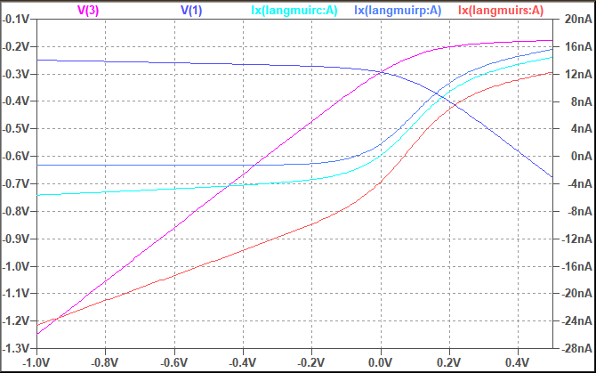
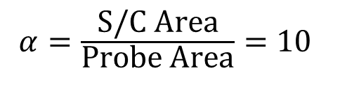
Simulating Area Ratio Effects… contd
Voltage w.r.t. Vp
$α=\frac{\text{S}\text{/}\text{C} \text{Area}}{\text{Probe} \text{Area}}=10$
S/C charges to -0.25 V
i.e. more positive than otherwise !
LP is applied voltage w.r.t the S/C chassis ground.
As LP sweeps positive and collects more electron current, the S/C chassis charges more negative… LP never makes it past Vp
Applied Voltage w.r.t. Vs/c

Slide 16
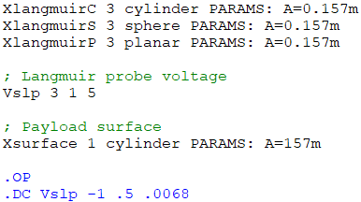
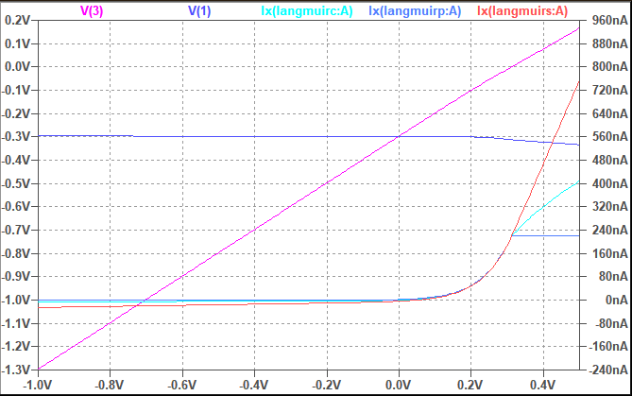
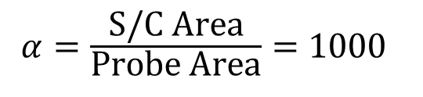
Simulating Area Ratio Effects… contd
Voltage w.r.t. Vp
$α=\frac{\text{S}\text{/}\text{C} \text{Area}}{\text{Probe} \text{Area}}=1000$
Applied Voltage w.r.t. Vs/c
S/C now charges to nominal -0.3 V
LP sweeps still charges the spacecraft surface, but this time LP does make it past Vp.

Slide 17
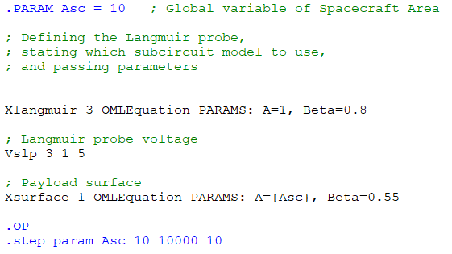
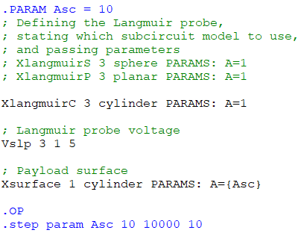
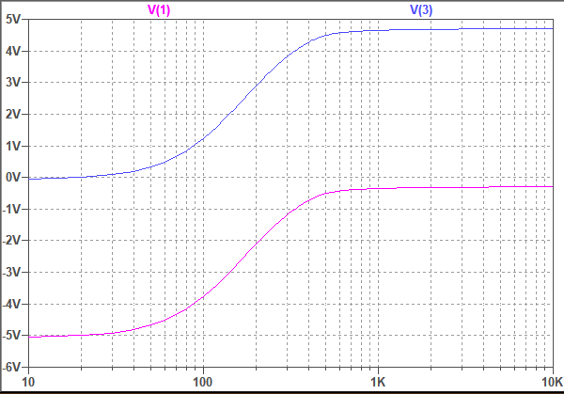
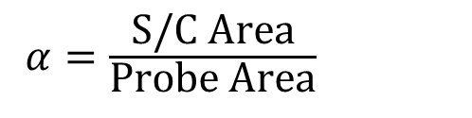
Simulating Area Ratio Effects… contd
Voltage w.r.t. Vp
$α=\frac{\text{S}\text{/}\text{C} \text{Area}}{\text{Probe} \text{Area}}$
Note the parametric sweep above
S/C charges to -0.3 V
As the S/C to probe ratio increases beyond 10³ the charging effect becomes negligible, and approaches zero at 10⁴.
This was also analytically shown by Szuszczewicz [1972].

Slide 18
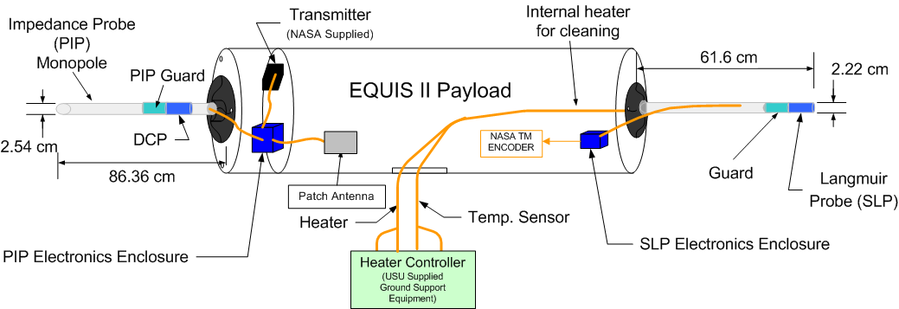
Case Study – EQUIS II Rocket
Rocket Launched from Kwajalein, Aug 2004
Ratio of payload surface area to that of combined SLP probe + guard surface area was about ~120

Slide 19
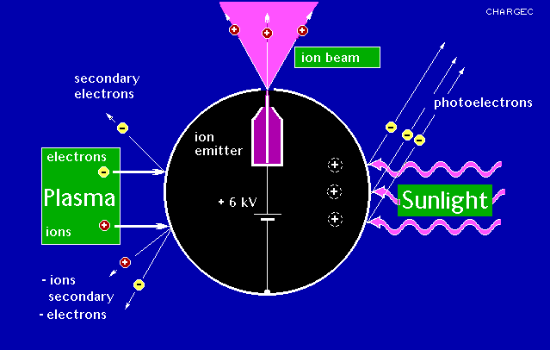
Spacecraft Charging
I_{E} = Electron Current
I_{I} = Ion Current
I_{RAM}=Ram Current
I_{PH}=Photoelectron
I_{SE}=Secondary Electron
I_{BSE}=Back Scatter
I_{B}=Beam/Ion thruster
V_{p} = Floating Potential / Charging
[I_{E} (V_{p}) + I_{B}(V_{p})] - [ I_{I} (V_{p}) + I_{RAM} (V_{p}) + I_{PH}(V_{p}) +I_{SE}(V_{p}) + I_{BSE}(V_{p})] = 0
[Outgoing current - Incoming current] @ floating potential = 0

Slide 20
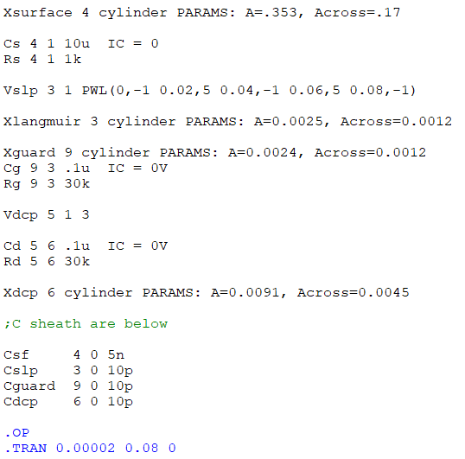
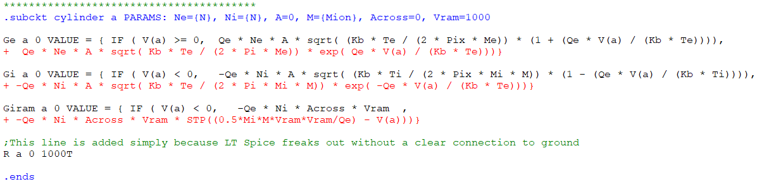
Case Study – EQUIS II Rocket
SPICE Model

Slide 21
Case Study – EQUIS II Rocket
Model Results: Sweep ‘warping’ due to small area ratio.

Slide 22
Case Study – EQUIS II Rocket
Observed Data
Affected by SLP sweeps as well as PSP sweeps.

Slide 23
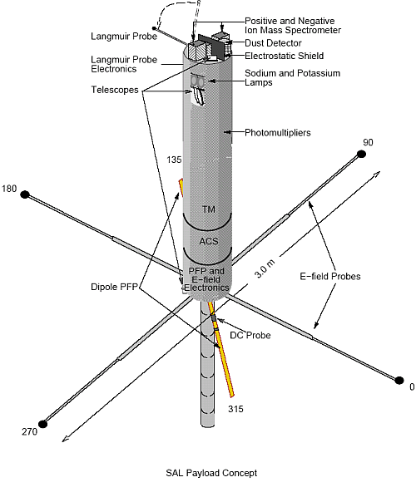
Case Study – Sudden Atom Layer Rocket
Flight: 19th Feb 1998, Puerto Rico 2009 LT
Investigation of sporadic sodium layers
Dust Detector
Floating Potential Probes
Swept Impedance Probe
DC Langmuir Probe (DCP)

Slide 24
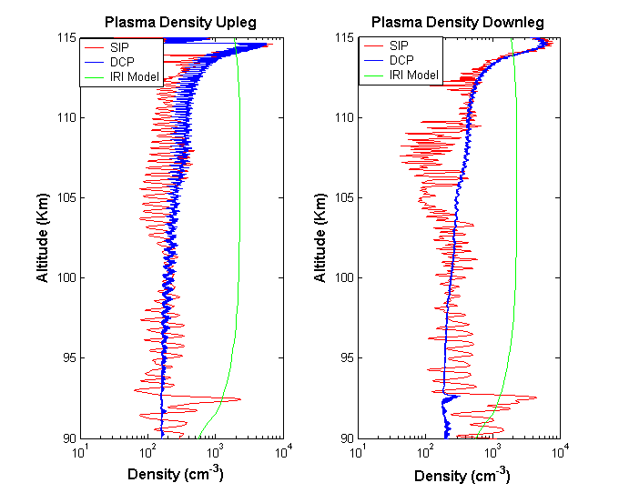
Case Study – Sudden Atom Layer Rocket
Charged Dust Layer

Slide 25
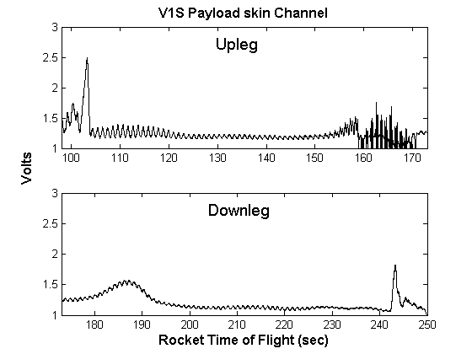
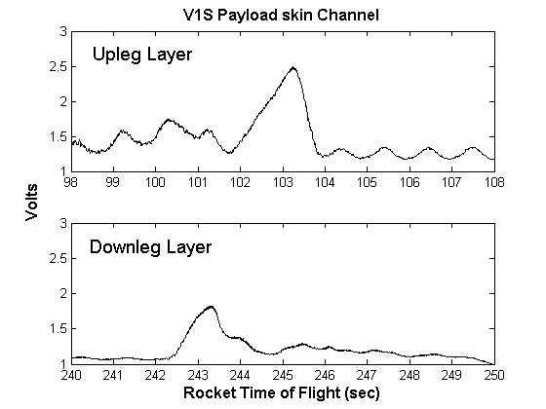
Case Study – Sudden Atom Layer Rocket

Slide 26
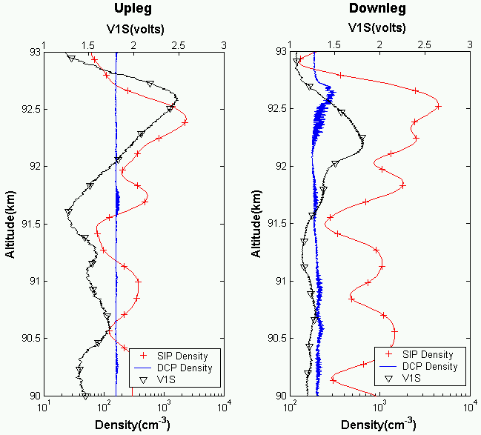
Case Study – Sudden Atom Layer Rocket

Slide 27
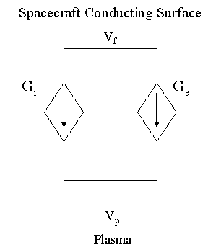
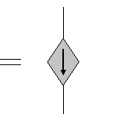

Case Study – Sudden Atom Layer Rocket
Circuit model in SPICE
Using Cylindrical OML equations
With correct probe to skin area ratios
S/C Charging Potential = -1.3 Volts

Slide 28
Case Study – Sudden Atom Layer Rocket
Triboelectric Charging:
When two metal surfaces come in contact with each other and then separate, the metal surface with lower work function gets charged positive and the other surface gets charged negative
Work function: Aluminium: 4.2eV Sodium: 2.36eV
➔ Dust source of electron current
Dust current: modeled as RAM current

Slide 29
Case Study – Sudden Atom Layer Rocket
Observed Dataset
Triboelectric Charging
Simulation Results

Slide 30
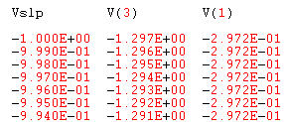
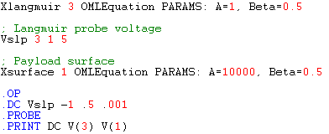
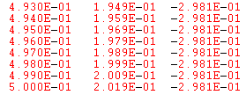
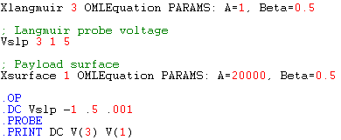
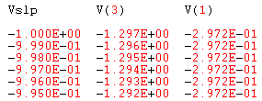

Understanding Floating Potential
First… Lets look at detailed Floating Potential of Probe and Surface when area ratio is 10,000
Notice that V(1) (i.e. surface) charges by 0.8mV when ratio is 10K. Negligible, but not zero.
When ratio is 20K. Charging is in uV and not discernible.

Slide 31
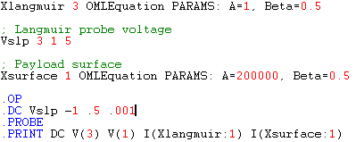
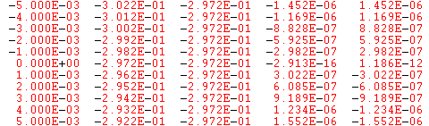
Understanding Floating Potential… contd
Second… Lets look at detailed current and potentials of surface and Langmuir probe
So essentially, the “Zero current” is at 0 applied potential. Because Langmuir probe is now at same potential as the surface which is floating!

Slide 32
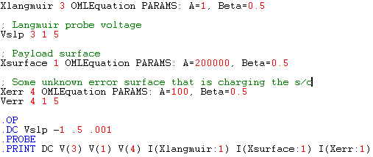



Understanding Floating Potential… contd
Third… Lets look at detailed current and potentials when extraneous charging is there
Langmuir probe reaches *its* Floating Potential at same -0.297V w.r.t. plasma, but the Payload is charged a bit more negative (-1.13V to be exact) in order to balance the current coming from Xerr extraneously biased surface.
Thus, now the Langmuir probe has to bias +1.13 V to reach its Zero current value which makes it reach its floating potential of -.297 w.r.t. plasma.
This implies that the applied Vslp that results in Islp=0 is the additional charging of the payload and *not* the true floating potential of the payload.

Slide 33
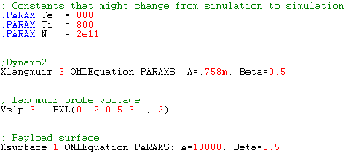
Understanding Floating Potential… contd
Fourth… How bad does it get with contamination and hysteresis… Lets look at Dynamo2
There is no significant charging!
Note that Vslp = V(3)-V(1).
So the current zero crossing is
at essentially zero applied Vslp voltage.

Slide 34
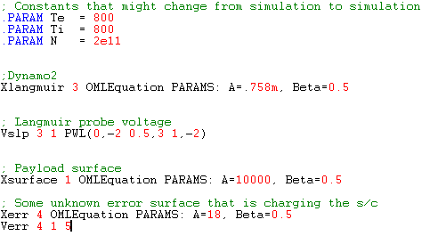

Understanding Floating Potential… contd
Fourth (contd)… Lets add charging
Now charging to -0.44V as seen by
SLP, but no hysteresis and the real
charging relative to plasma is -.75V

Slide 35
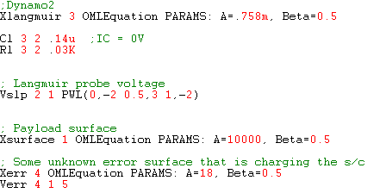

Understanding Floating Potential… contd
Fourth (contd)… Lets add reasonable RC on probe
No meaningful hysteresis.
No matter what reasonable RC
values we give.

Slide 36

Understanding Floating Potential… contd
Fourth (contd)… Lets add RC on the payload surface
V(3)-V(9) =
UpSweep = +.78
DownSweep = +1.177
True surface potential is V(1) which is about -.69V w.r.t. plasma during upsweep and -.62 V during downsweep.

Slide 37
Summary
Several SPICE programs are commercially available either as freeware or for minimal costs.
The numerical solvers available within SPICE can be used to rapidly and simultaneously calculate spacecraft floating potential, as well as instrument response, including all the transient capacitive effects… correct within the order of magnitude.
Such modelling is relatively easy to do and should be done for every mission where Langmuir probes are part of the mission.

